Slide 1
SEMPY01
Recombination

Slide 2
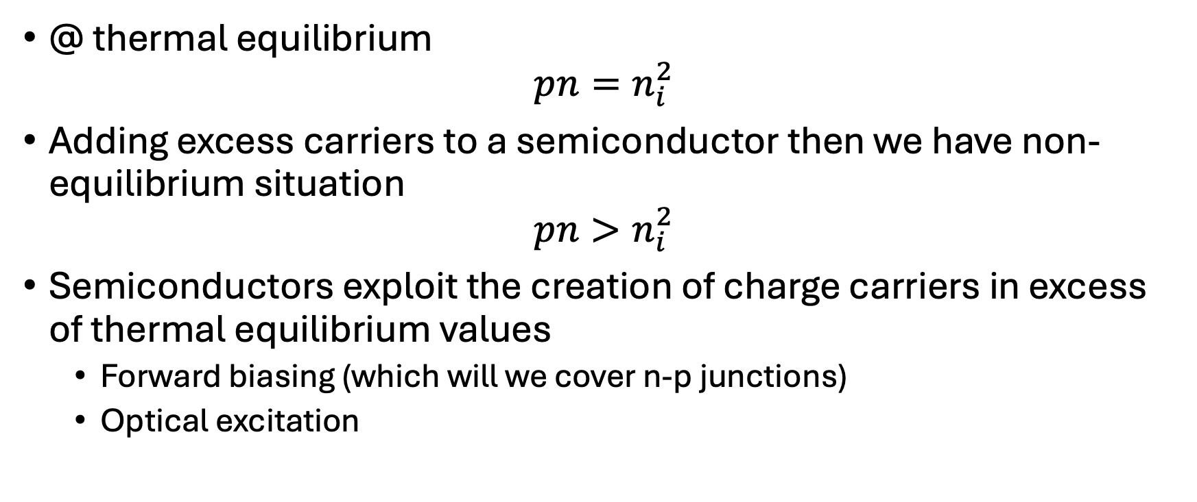
Thermal Equilibrium
@ thermal equilibrium
$$pn=n_{i}^{2}$$
Adding excess carriers to a semiconductor then we have non-equilibrium situation
$$pn>n_{i}^{2}$$
Semiconductors exploit the creation of charge carriers in excess of thermal equilibrium values
  Forward biasing (which will we cover n-p junctions)
  Optical excitation

Slide 3
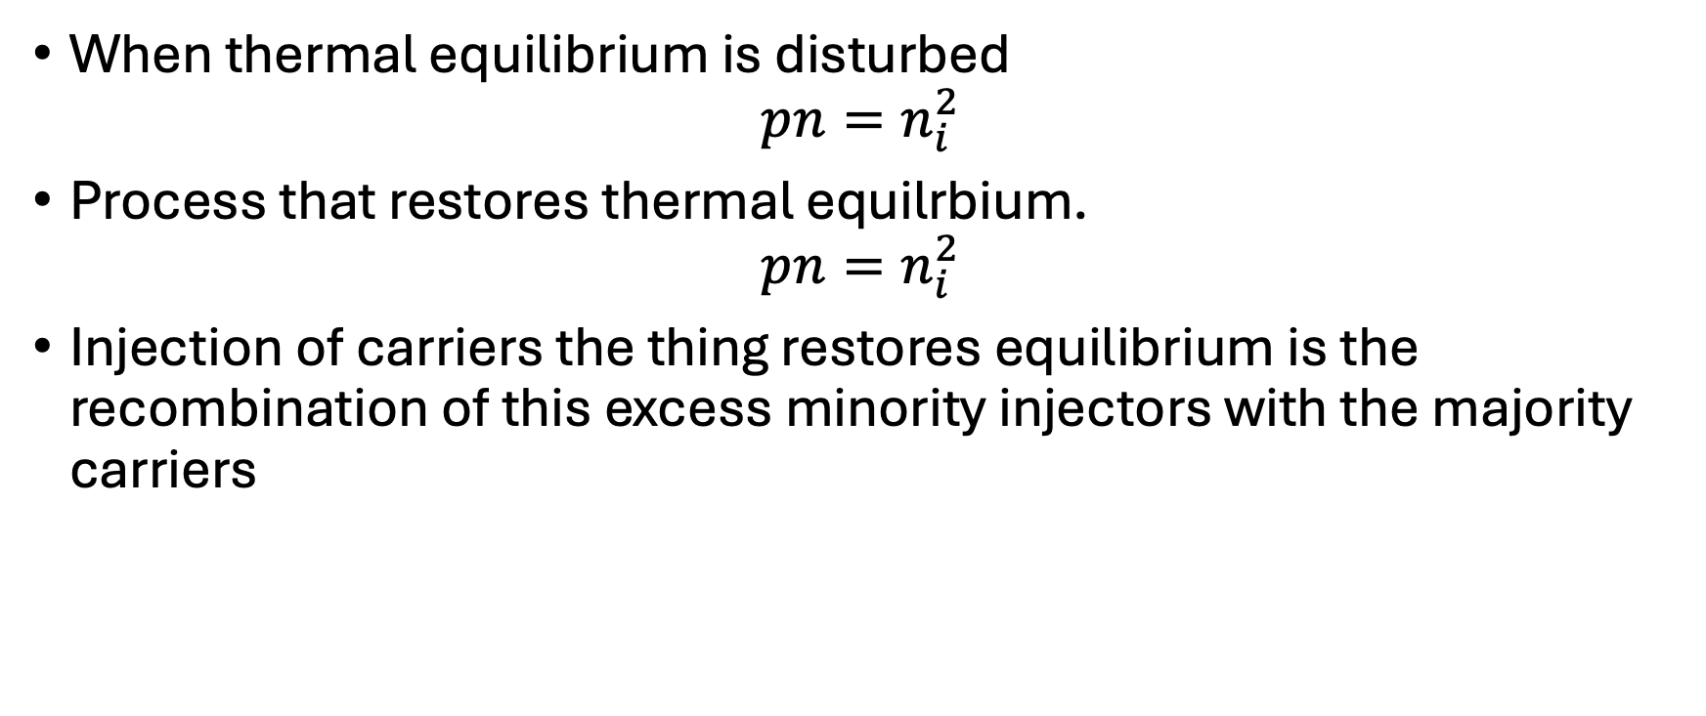
When thermal equilibrium is disturbed
$$pn=n_{i}^{2}$$
Process that restores thermal equilrbium.
$$pn=n_{i}^{2}$$
Injection of carriers the thing restores equilibrium is the recombination of this excess minority injectors with the majority carriers

Slide 4
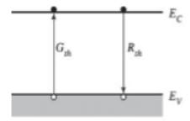

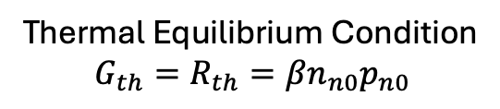
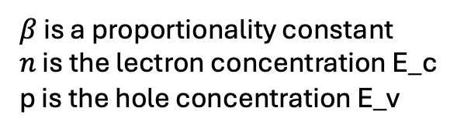

Direct Recombination (n-type)
$$G_{th}=R_{th}→G_{th}−R_{th}=0$$
$$R=βnp$$
$β$ is a proportionality constant
$n$ is the lectron concentration E_c
p is the hole concentration E_v
Thermal Equilibrium Condition
$$G_{th}=R_{th}=βn_{n0}p_{n0}$$

Slide 5
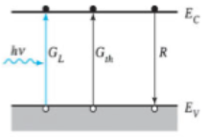




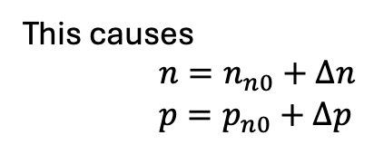

$$G=G_{th}+G_{L}$$
This causes
$n=n_{n0}+Δn$
$p=p_{n0}+Δp$
$$G_{L}+G_{th}−R$$
At steady state, the net generation rate = the net combination rate

